Slide 1

Simple ANN
Alina, Aliyanur, Tomiris

Slide 2
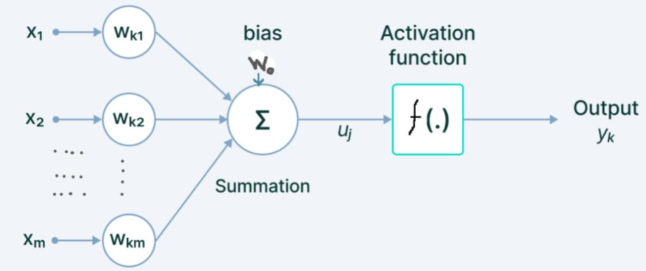
ANN – Artificial Neural Network
An artificial neuron is a mathematical model inspired by a biological neuron that receives multiple input signals, multiplies them by weights, adds a bias, and applies an activation function to produce an output.

Slide 3
Components of an Artificial neuron
Inputs: They are usually represented as features of a dataset which are passed on to a neural network to make predictions.
Weights: These are the real values associated with the features. They are significant as they tell the importance of each feature which is passed as an input to the ANN.
Bias: Bias in a neural network is required to shift the activation function across the plane either towards the left or the right. We will cover it in more detail later.
Summation function: It is defined as the function which sums up the product of the weight and the features with bias.
Activation function: It is required to add non-linearity to the neural network model.

Slide 4
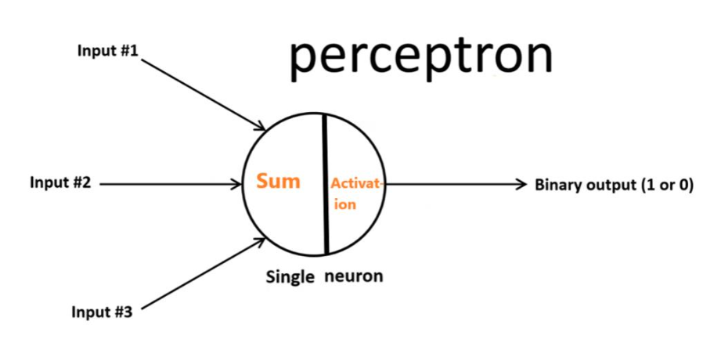
In artificial neural networks, each neuron forms a weighted sum of its inputs and passes the resulting scalar value through a function referred to as an activation function to produce an output.

Slide 5
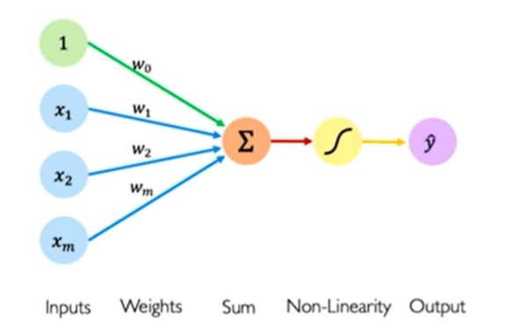
Four main parameters
The perceptron model begins with multiplying all input values (Xs) and their weights (Ws).
Add these values to create the weighted sum.
Add a bias value (W0) to this weighted sum to improve the model’s performance.
This weighted sum is applied to the activation function ‘f()’ to obtain the desired output.

Slide 6
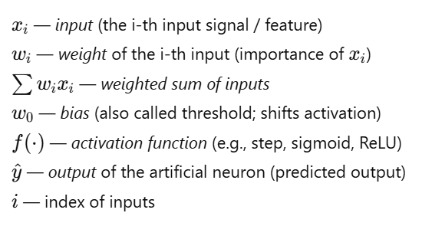

Math model

Slide 7
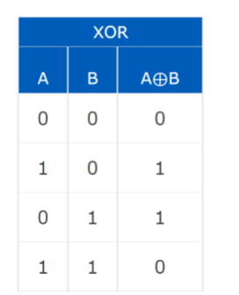
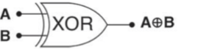

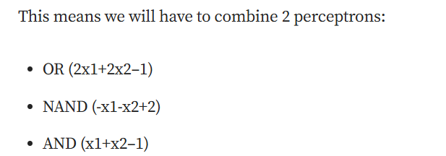

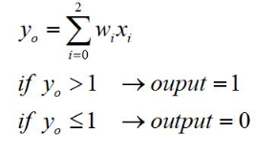
Calculating weight for XOR gate
Single perceptron doesn’t work here, need 2 layers to find a weights.
Error occurs when A = 1, B = 1.
Formulas:

Slide 8
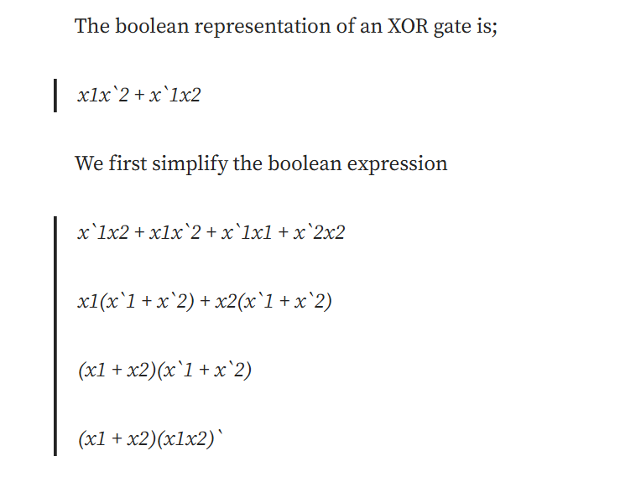

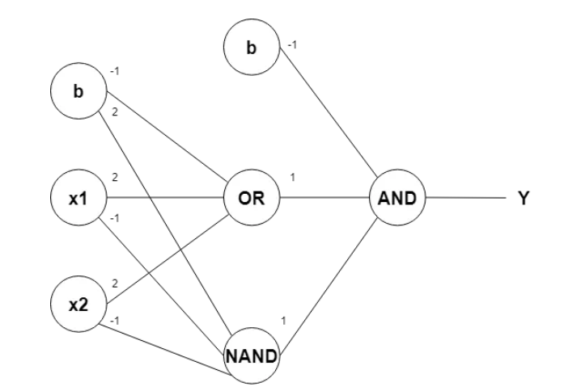

Slide 9
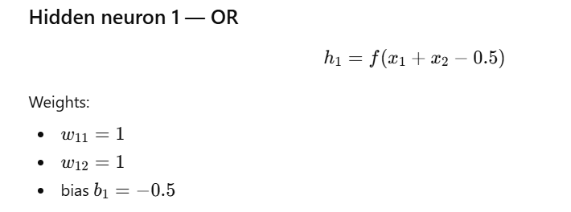

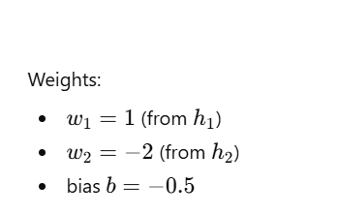


Slide 10
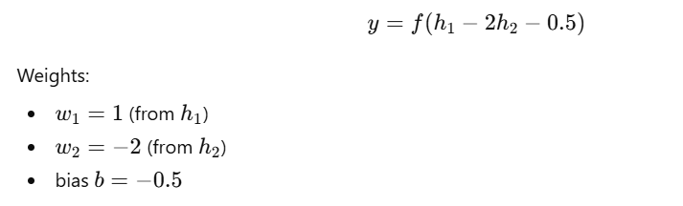
Output neuron XOR

Slide 11

THANKS!

